Slide 1
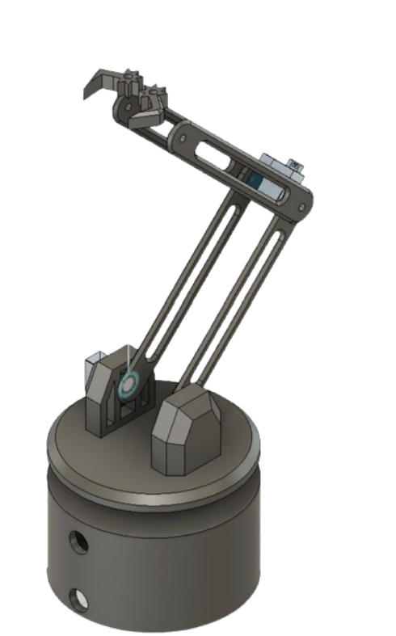



Color Conscious Contraption presents:
Color Sensing Robot Arm
By: Asheeyana, Bethia, Bernadette, Dylan, Kelley, Tâm

Slide 2
Table of Contents
01 Introduction
02 Methodology
03 Resources/Materials
04 Design
05 Electrical
06 Programming

Slide 3
01
Introduction

Slide 4
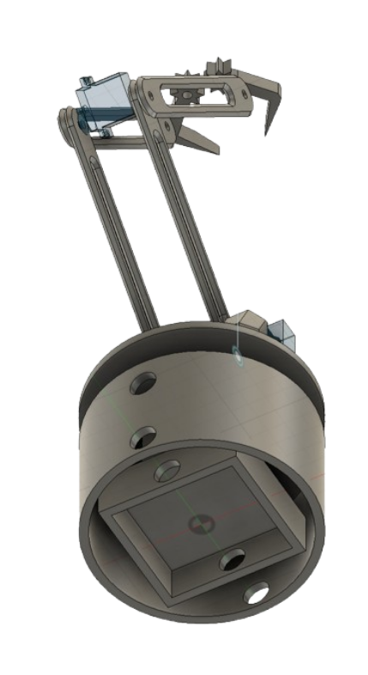
Robot Arm
INTRODUCTION
Color Sensing Robot Arm
Our robot arm can sense different colored blocks and organize them into colored spaces. It has three movable points: one for the base, one for the joint, and the last one for the claw.

Slide 5
02
Methodology

Slide 6
METHODOLOGY
Tools & Applications
Design
Schematics
Programming
01
02
03
AutoCAD is used to model the overall design of the arm, part by part, and a 3D printer is used to physically create it.
Easy EDA is used to design the circuit schematics, and a TinkerCAD simulation is used to test the program.
C++ is the programming language used to write the code to operate the robot arm, and Arduino IDE is used to implement it.

Slide 7
METHODOLOGY
Progress Timeline
Meeting 3: March 24
Start CAD for mechanical and electrical elements.
Meeting 2: March 20
Meeting 4: March 31
Begin ideating, designing, and planning for future meetings.
Begin programming for movement and color sorting in C++.

Slide 8
Meeting 5: April 2
Meeting 9: April 21
Begin testing and troubleshooting utilizing TinkerCAD.
Wrap up troubleshooting and presentation.
Meeting 7: April 13
3D print CAD and mechanically assemble the robot arm.

Slide 9
03
Resources/ Materials

Slide 10
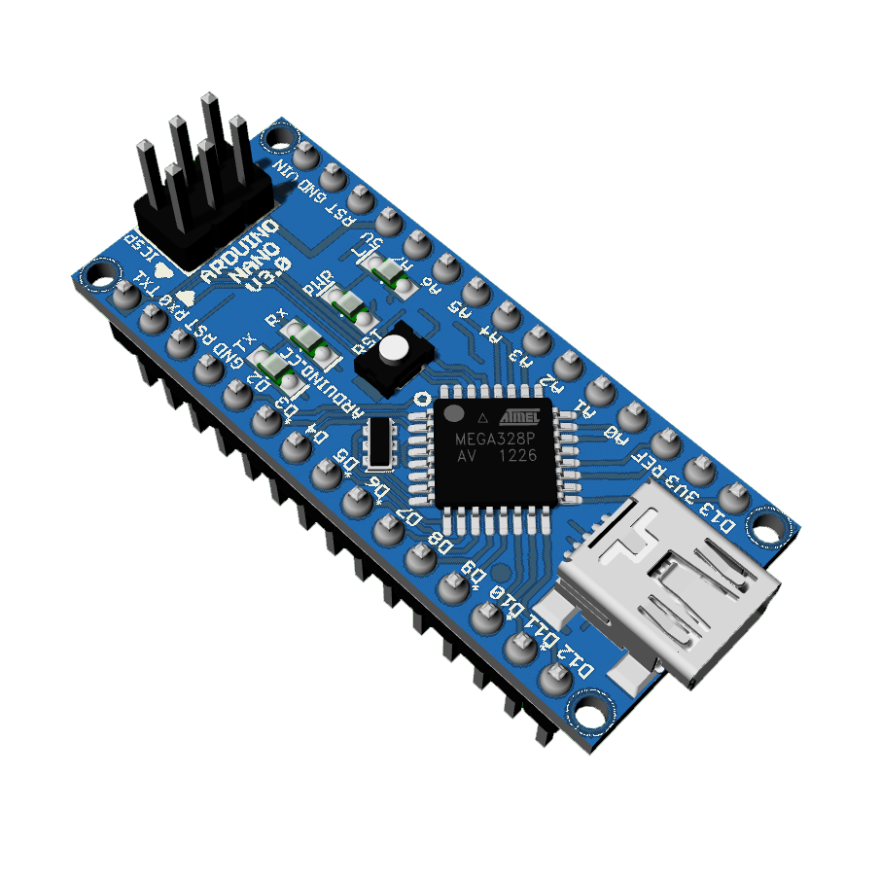
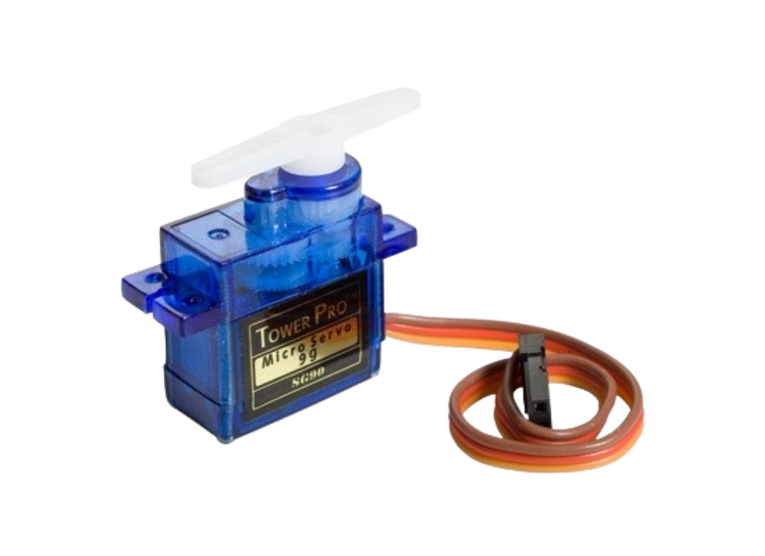
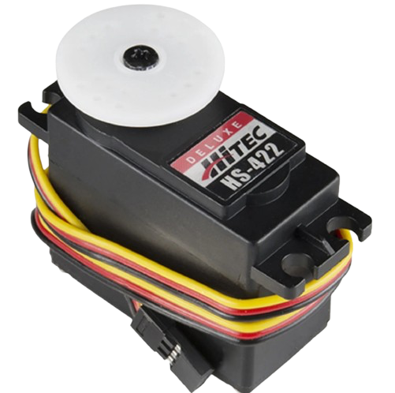
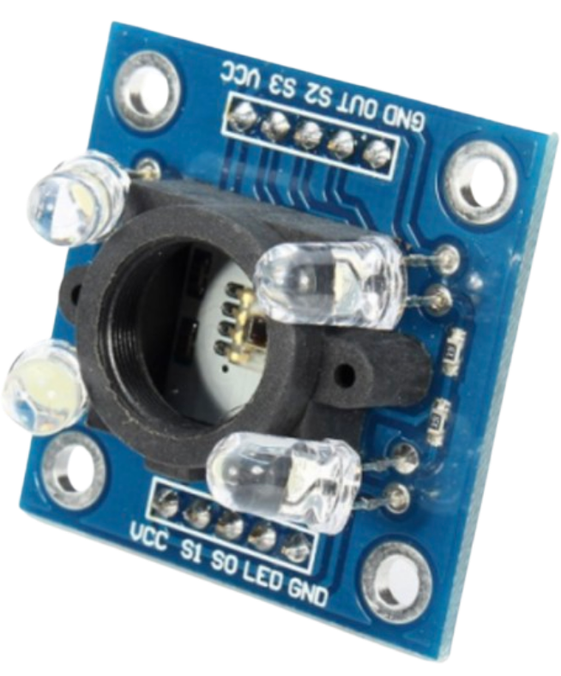
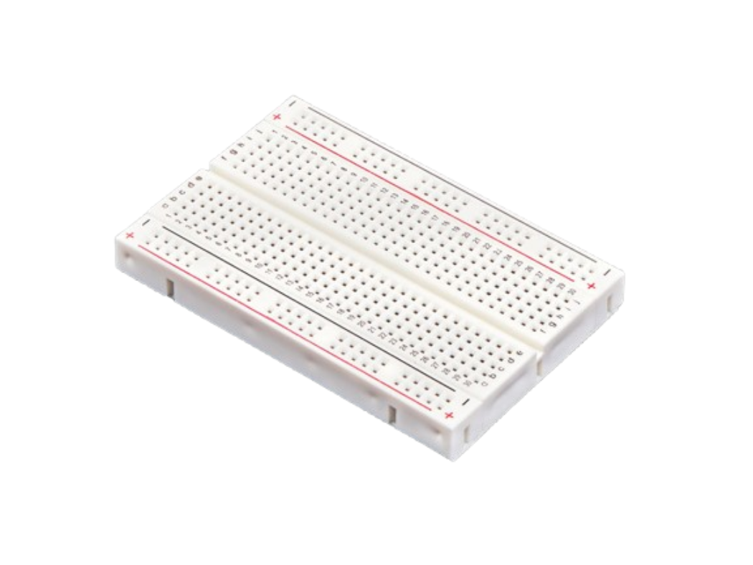
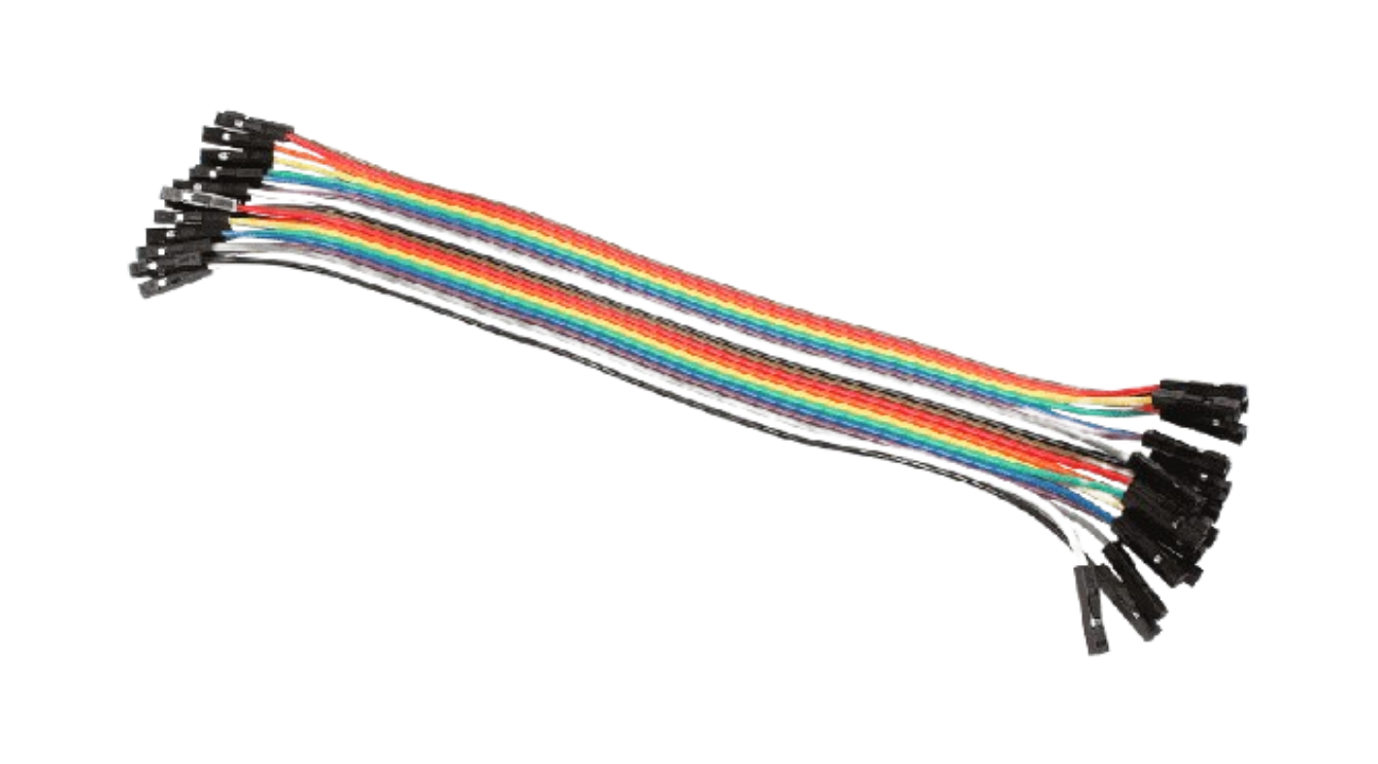
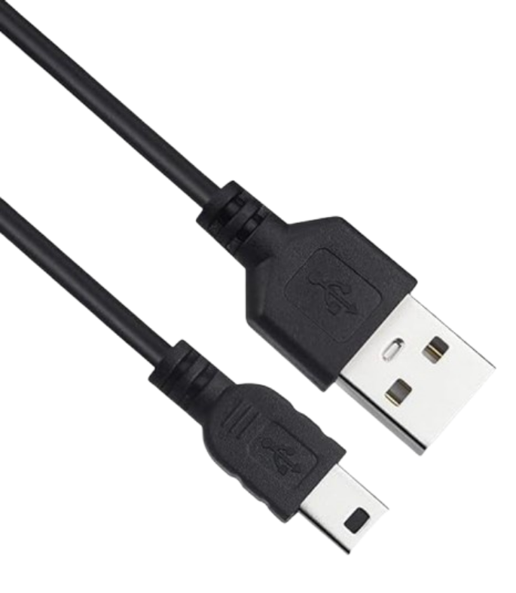
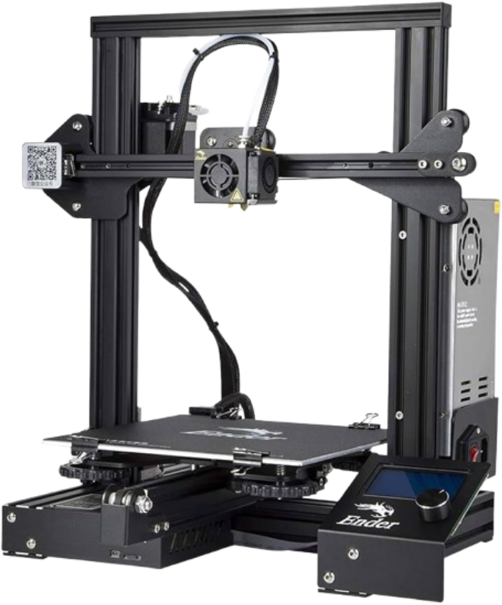
Materials
RESOURCES/
Arduino Nano
Microcomputer
Micro Servos
Motors for joints
Standard Servo
Motor for base
TCS3200 Color Sensor
Detects RGB values for Arduino
Breadboard
Creates experimental circuit
Wires
Connect components
USB Cable
Connects Arduino to PC
3D Printer
Prints robot parts
Arduino Nano
Micro Servos
Standard Servo
TCS3200
Breadboard
Wires
USB Cable
3D Printer

Slide 11
04
Design

Slide 12
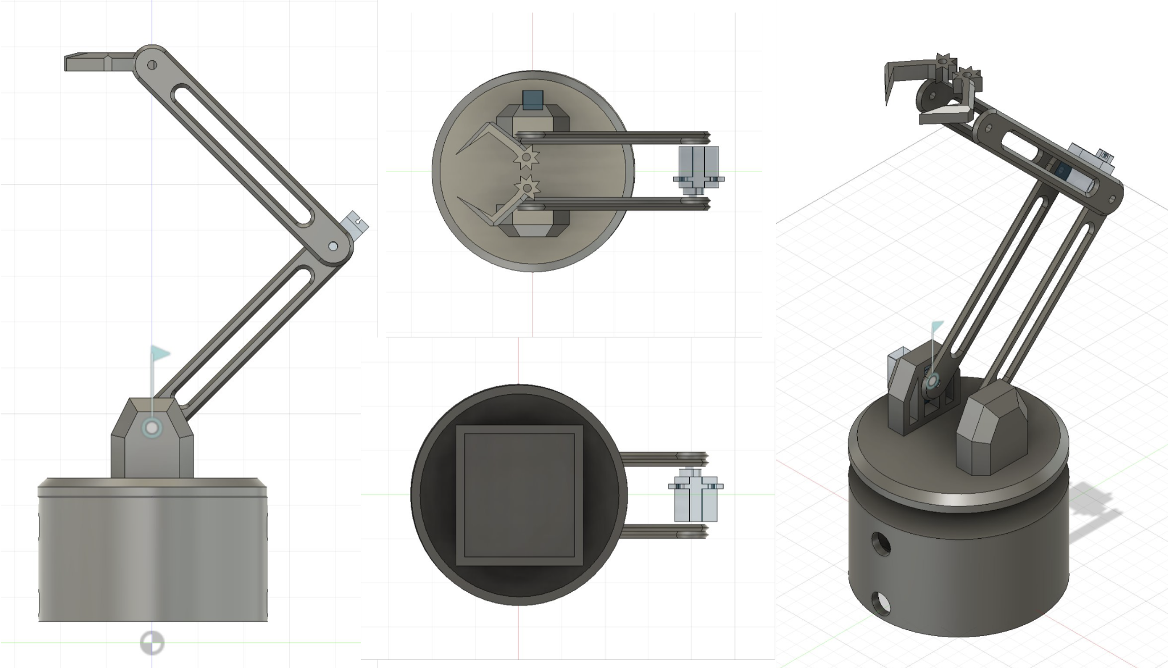
CAD
DESIGN

Slide 13
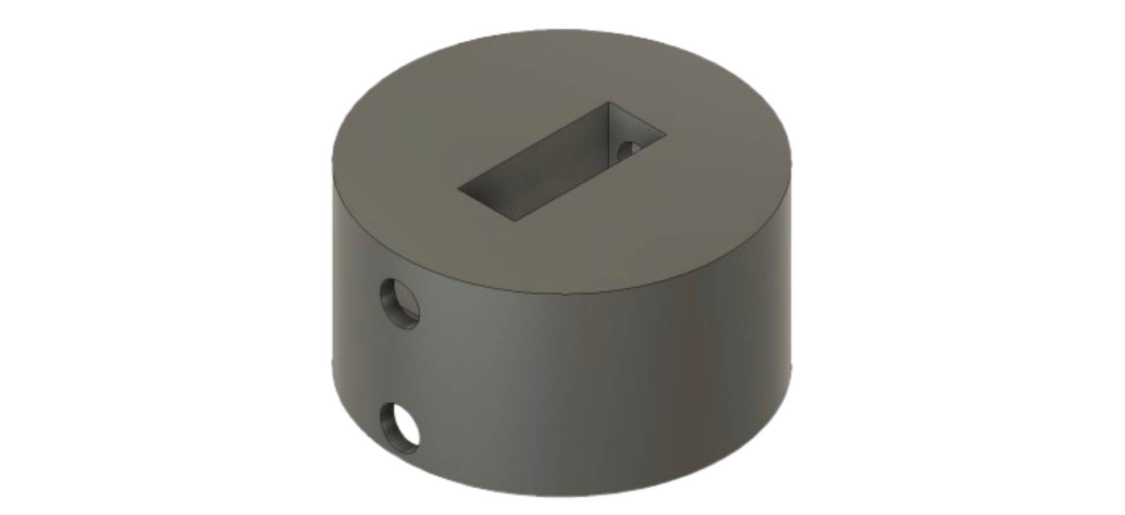
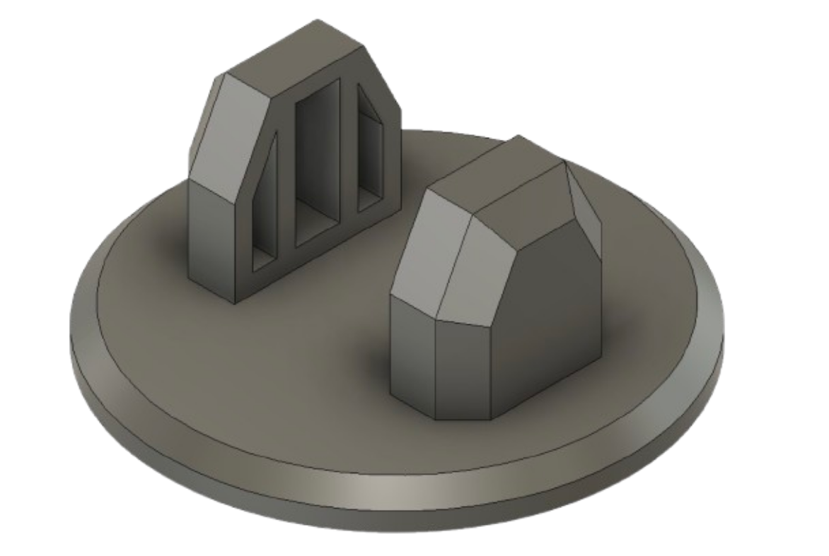
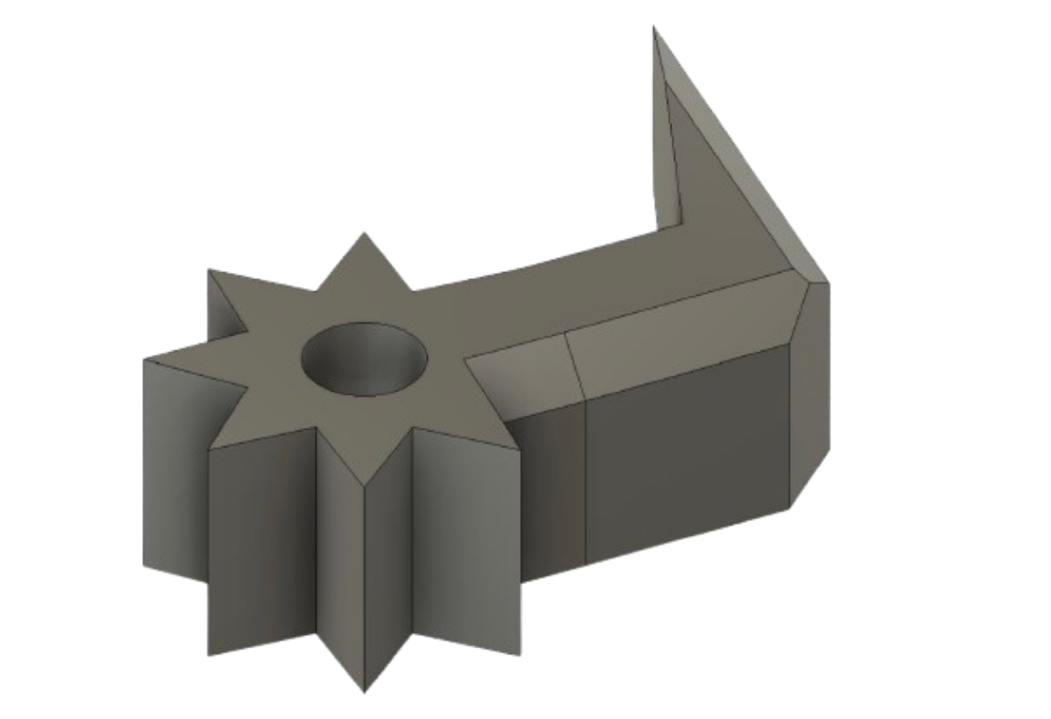
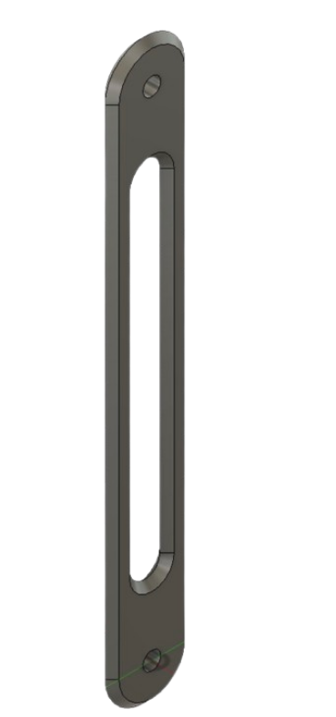
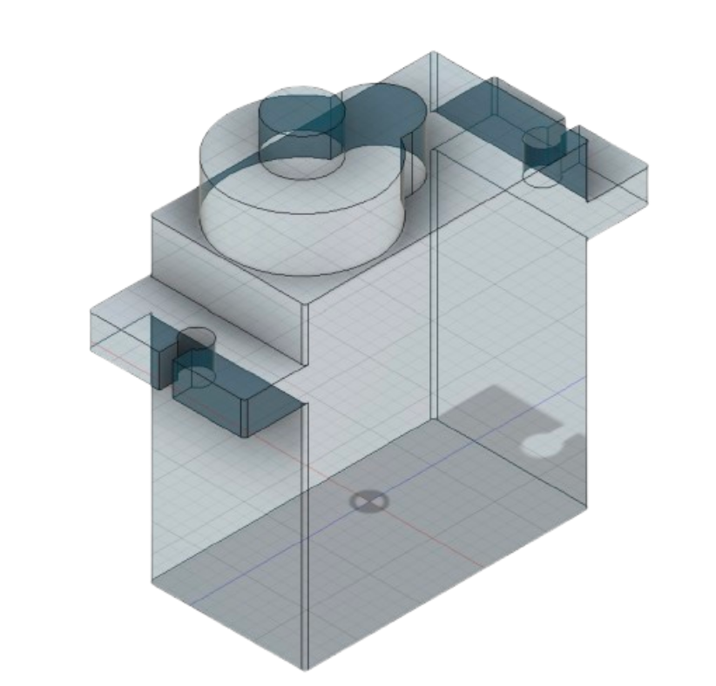
Parts
DESIGN
Base Bottom
Remains stationary, contains standard servo
Base Top
Rotates and supports the rest of the arm
Claw (Left & Right)
Interlock to operate in tandem
Intermediate arms
Support motors and movement, hollow to reduce load
Servo Motors
Creates movement to operate the arm
Base Bottom
Base Top
Claw Left
Claw Right
#000000
Intermediate Arm
Servo Motor

Slide 14
05
Electrical

Slide 15
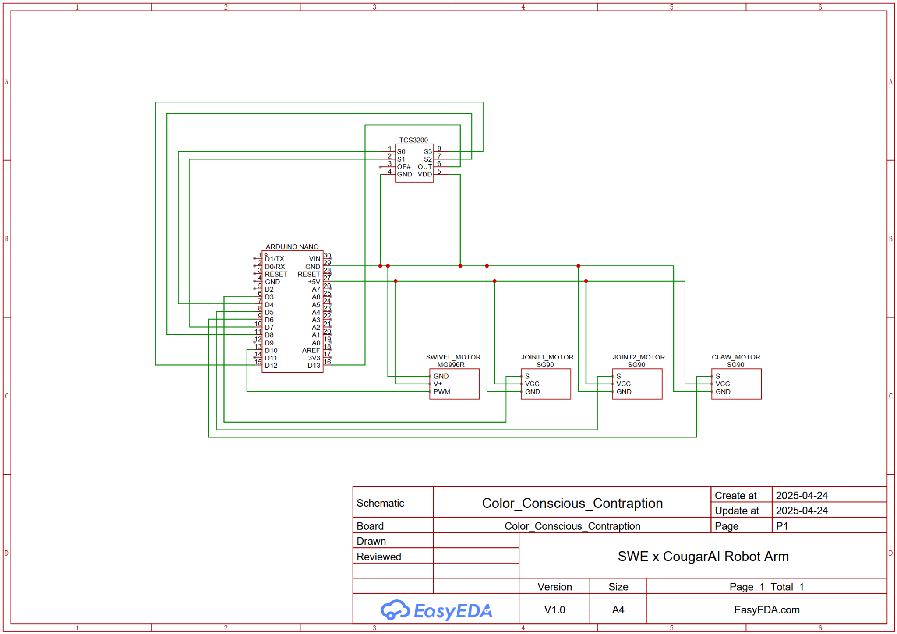
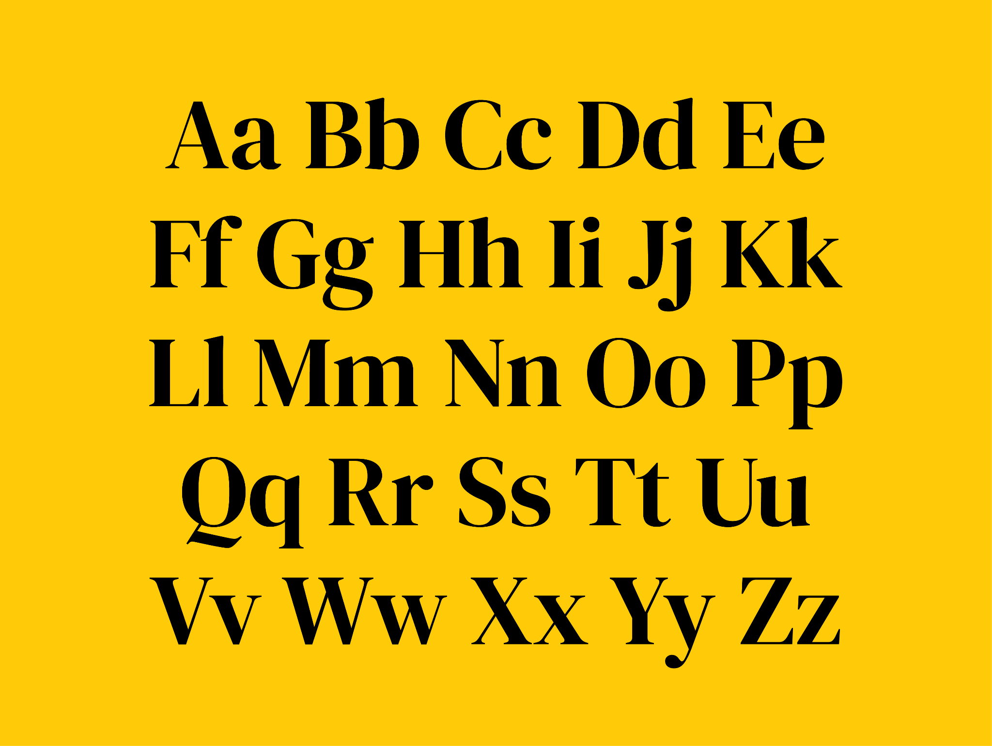
Schematic
ELECTRICAL

Slide 16
06
Programming

Slide 17
PROGRAMMING
Coding
Variables
Sorting
Movement
01
02
03
Utilize const function to define variables to establish color sensor pins, bin positions, pickup position, and claw open/closed positions.
Function readColor() initializes red, green, and blue, then filters color sensor input with if statements to determine the color being seen.
Function MoveArm(angle1, angle2) assigns 2 angles to move the arm’s joints, then created function pickAndPlace using the servo motors to move the item in front of the claw to the appropriate bin.

Slide 18
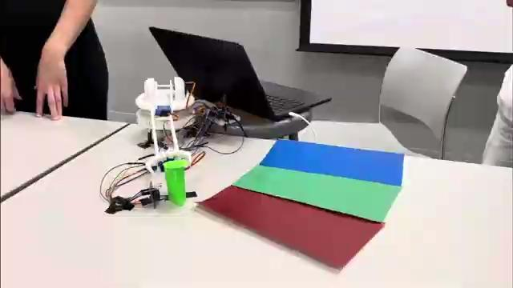
Final Product
ROBOT ARM

Slide 19
Thank you!
Color Conscious Contraption presents:
Color Sensing Robot Arm
By: Asheeyana, Bethia, Bernadette, Dylan, Kelley, Tâm

